Slide 1

Bangladesh University of Business and Technology(BUBT)
Dept. of Computer Science & Engineering
Project Proposal Presentation
On
ONLINE STREAMING PLATFORM

Slide 2
Supervisor
Group Member:
1. Md. Rashadul Islam – 19202103169 2. Md. Faysal Mahmud –174
3. Latiful Islam Shoishob –162
4. Sadia Sultana –184
5. Dipa Rani - 201
Md. Ali Azgor
Department of CSE
Bangladesh University of Business
& Technology

Slide 3
Outline
Introduction
Background Study
Motivation
Objective
Proposed Model
User
Requirements
References

Slide 4
Introduction
Streaming Media – a listening or viewing media in real time through WWW
User Watch & Listen Media through any device
No need to wait for download
Reduce time & anytime watch facilities

Slide 5
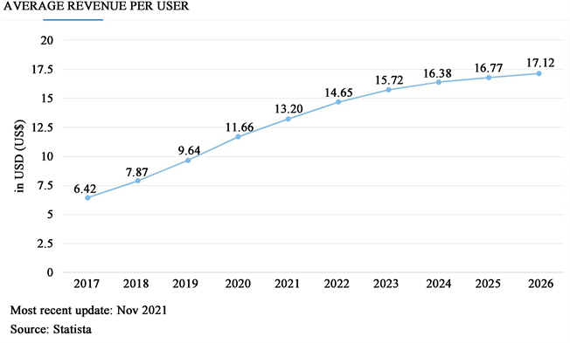
Background
Online Streaming Platform rapidly increasing now a days
Figure – Growth of OTT

Slide 6



Motivation
Figure – Some Popular OTT Platform in Bangladesh
No Preview system before login
Subscription cost matters

Slide 7
objective
To give a smooth video streaming experience
To give users a proper medium to entertain
Giving a preview to the users before registration
User Friendly interface and very low cost subscription
24/7 customer support

Slide 8
Requirements
Hardware Requirements
Software Requirements
Ram – Minimum 2 GB
A good internet connection
Compatible Browser
OS

Slide 9


Reference
https://www.scirp.org/journal/paperinformation.aspx?paperid=120234
https://www.chorki.com
https://www.bioscope.com
https://www.zee5.com

Slide 10
THANK YOU
For Your Valuable Time

